Slide 1
SQL Server : Scale out & performance
Christophe Laporte
SQL Server MVP / MCM

Slide 2







Christophe LAPORTE
~ depuis 1997
6.5 <= SQL Server <= 2016
christophe_laporte@hotmail.fr
http://conseilit.wordpress.com/
@conseilit

Slide 3




Merci à nos volontaires

Slide 4








Merci à nos sponsors

Slide 5
Agenda
Scaling for performance

Slide 6
What Is Scale { up | out }
Scalability is the ability of an application to efficiently use more resources in order to do more useful work.
Scale Up
Bigger box
Scale Out
Expending to multiple servers
Notes:
https://msdn.microsoft.com/en-us/library/aa479364.aspx

Slide 7
Scale up
Historically
Processors speed
More cores
More RAM
Disks faster and faster (SSD/PCI/NVMe)
Problem with scaling up
Fault tolerance very expensive
Scaling on-demand
Support high-end workload
Workload changes

Slide 8
But …
Locks
Latches
Only 1 TempDB (GAM / SGAM / PFS)
InMemory table | durability = schema_only
1 transaction log file / Limit of Log Manager
Delayed durability
Notes:
https://blogs.msdn.microsoft.com/sqlcat/2013/09/10/diagnosing-transaction-log-performance-issues-and-limits-of-the-log-manager/
https://blogs.msdn.microsoft.com/sqlserverstorageengine/2006/07/08/under-the-covers-gam-sgam-and-pfs-pages/

Slide 9
Scale out
Scale out - the future ?
SQL
NoSQL
Scale out often means fault tolerant
Small DBs / instances
Easier to manage
Lower cost / commodity hardware
Geographically dispersed : data nearest end-user

Slide 10
How …
Middle Tier
Distributed partitioned view
Replication
Peer-to-peer replication
Log shipping
Scalable Shared Databases
Partitioned tables
Availability groups
Service broker

Slide 11
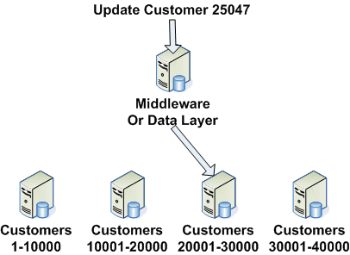
Middle Tier/ data layer
Data-dependent routing from middleware
Table /database / instance chosen by code
Boost performance with caching
Can be combined

Slide 12
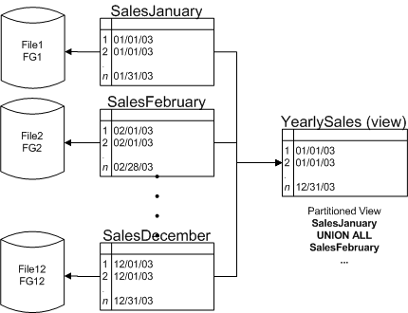
(Distributed) Partitioned Views
Can be spread across multiple servers
Local joins to not move data across servers
Smaller tables : easy to manage (Index, stats, checkdb)
Horizontal partitioning
Take care to restore point ….
Old fashion (SQL 2000)
Demo

Slide 13
Replication
Read-only
Easy to setup and manage
1 publisher / N subscribers
transactional replication
Read-Write
Merge replication
1..N publishers / 1..N subscribers
Slightly more complex to setup and manage
Require additional feature to load balance

Slide 14
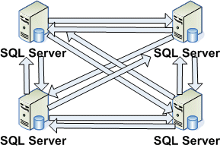
Peer-To-Peer Replication
Enterprise edition
Gaps / identity columns
Update frequency moderate
May be geographically dispersed

Slide 15
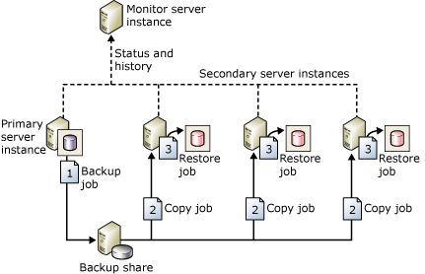
Log Shipping
Read-only
all editions
Large # of secondary
Latency to get up-to-date data
May be geographically dispersed
User disconnections during restores
Require additional feature to load balance

Slide 16
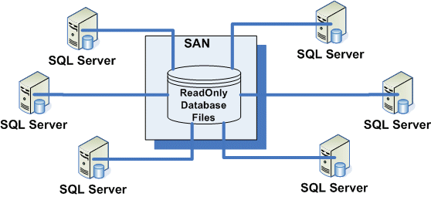
Scalable Shared Databases
Enterprise edition
Read-only
Updating the DB may be difficult / decrease availability
Require additional feature to load balance

Slide 17
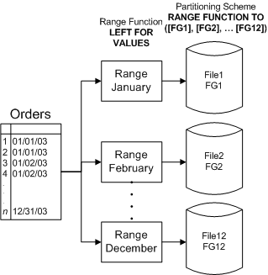
Partitioned Tables
Lock reduction (lock escalation at partition level)
Deal with different kind of storage / compression level
Truncate table / truncate partition (new in SQL 2016)
Page latch contention
Incremental Statistics
Edition enterprise
Demo

Slide 18
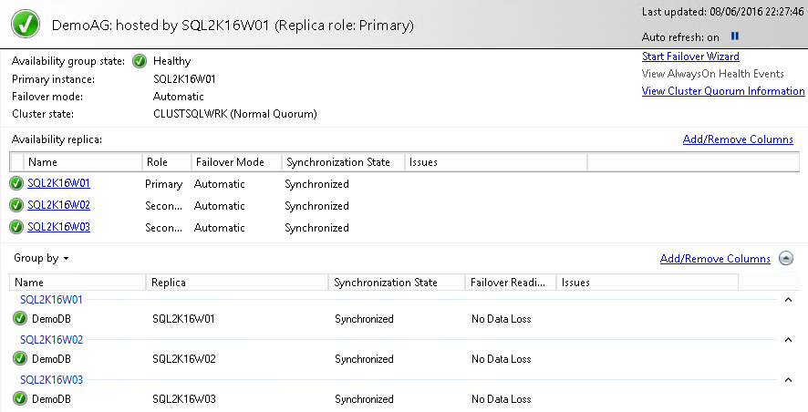
Availability Groups – RO load Balancing
Read Only Load Balancing : New in SQL Server 2016
Easy setup & does not require high skills on system administration
Enterprise edition
Domain agnostic
Up to 8 RO replicas
3 synchronous
Demo

Slide 19
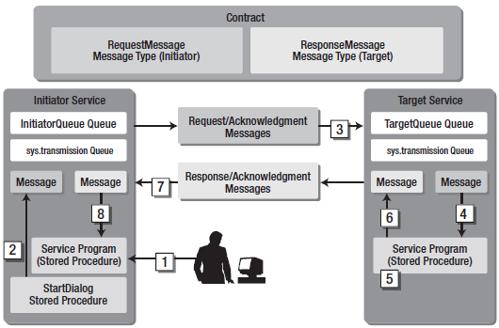
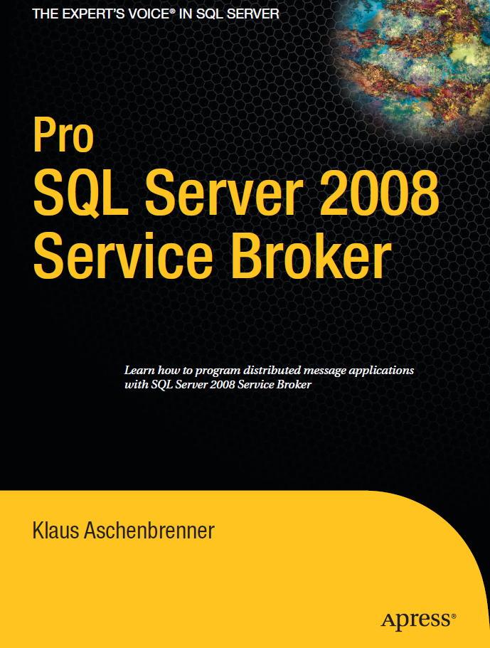
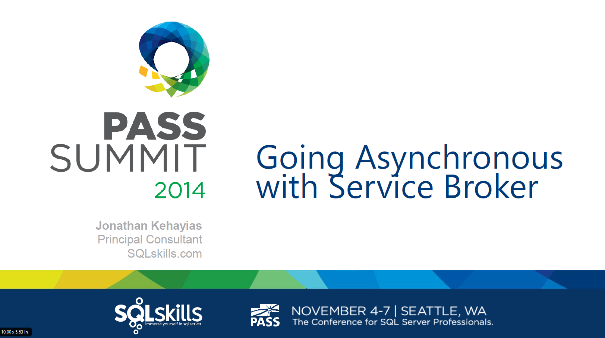
Service Broker
Asynchronous operations
Target
Same database
Same instance different database
Different instance
Routing between instances
N to 1
1 to N : load balancing
1 to N : multicasting
Notes:
http://rusanu.com/2011/07/20/how-to-multicast-messages-with-s
https://blogs.msdn.microsoft.com/sql_service_broker/2008/07/14/using-multiple-routes-in-service-broker/ql-server-service-broker/
https://msdn.microsoft.com/en-us/library/dd576261(v=sql.100).aspx
http://gavindraper.com/2012/06/03/sql-server-service-broker-explained/

Slide 20
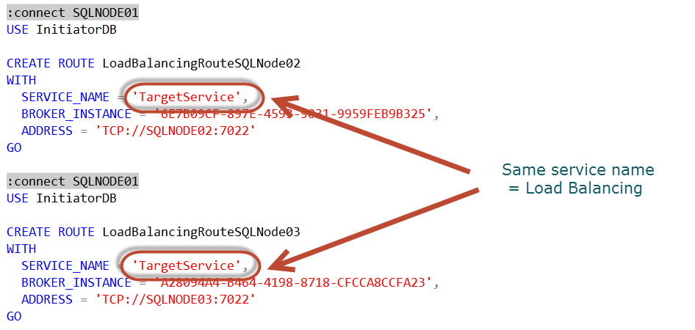
Demo – Service broker & NLB
SSB Load balancing
SQLNode01
SQLNode02
SQLNode03

Slide 21
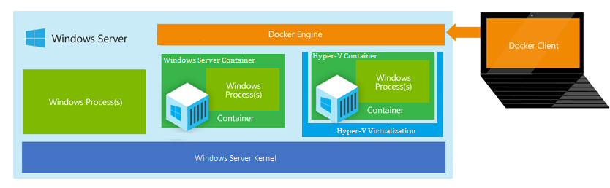
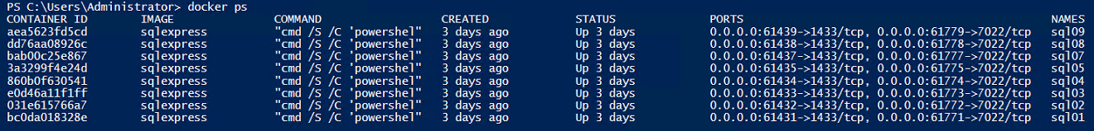
Windows Server containers / Docker
Micro services
Lightweight SQL Server instance
Quick response to load increase
To be combined with other solutions
Third party load balancer
(/!\ Replication /!\ )
Service Broker

Slide 22
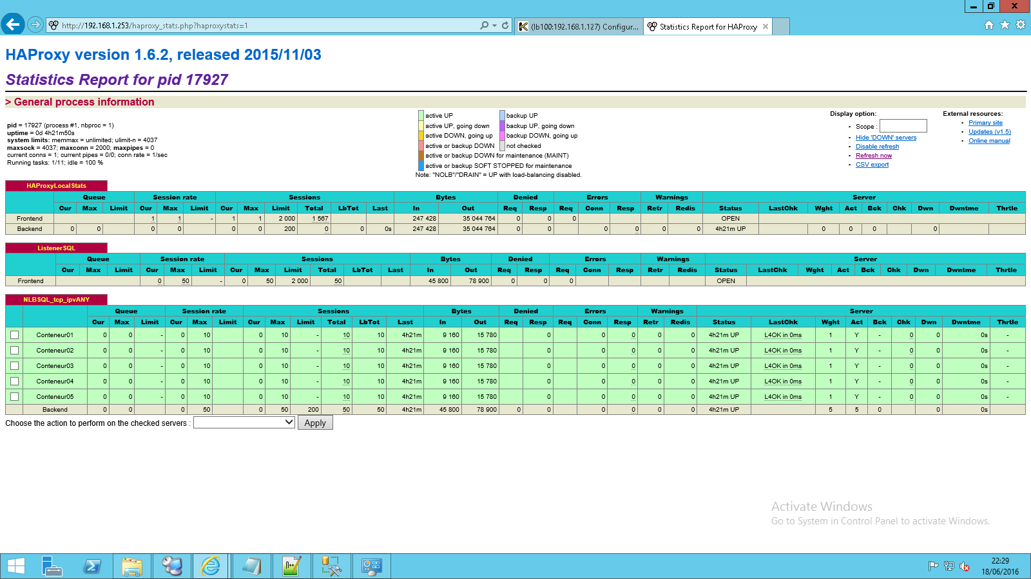
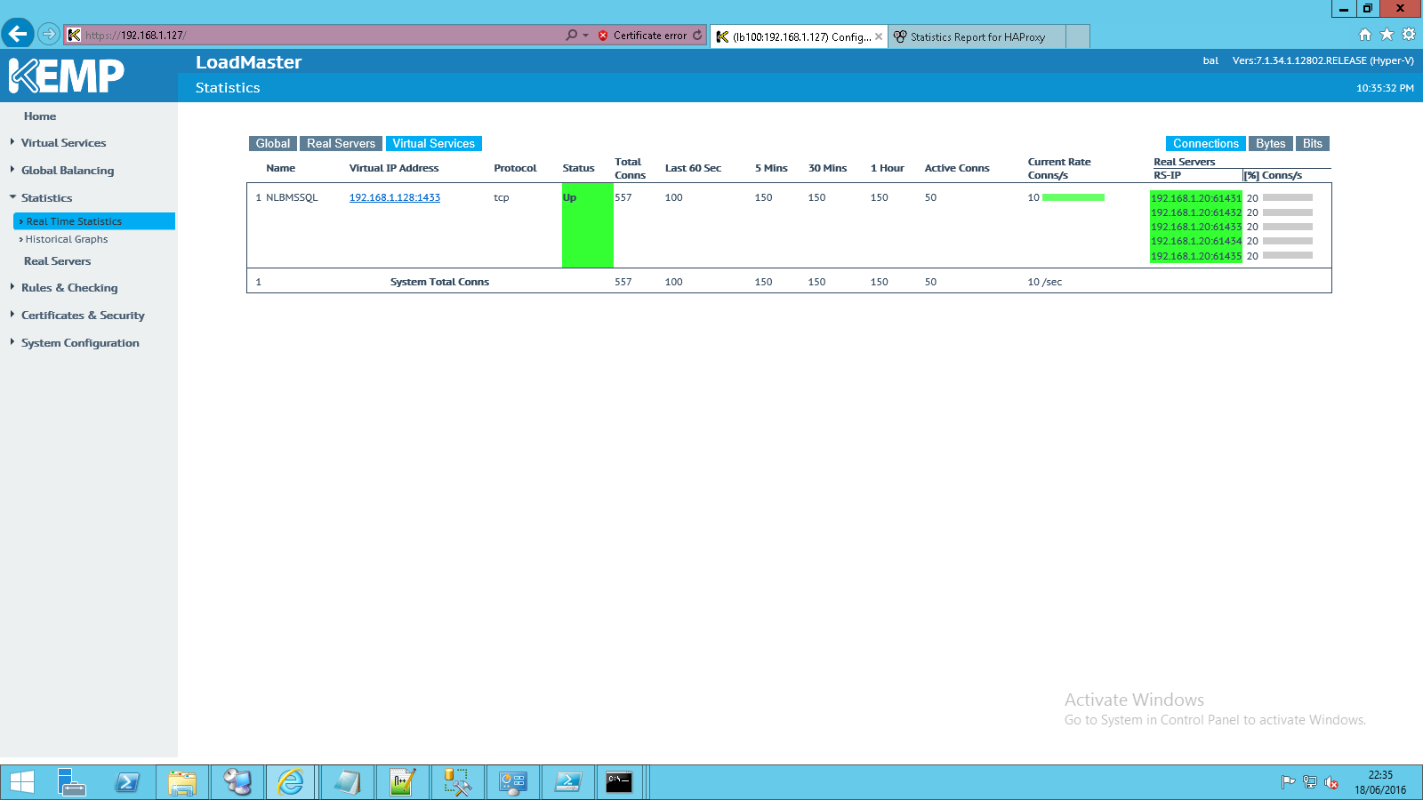
How to load balance workload
Windows NLB
Windows 2016 Software Load Balancing (SLB) for SDN
3rd party hardware
3rd party software
Kemp
Pfsense
Scalearc
Nginx
…
Notes:
https://technet.microsoft.com/en-US/library/mt632286.aspx

Slide 23
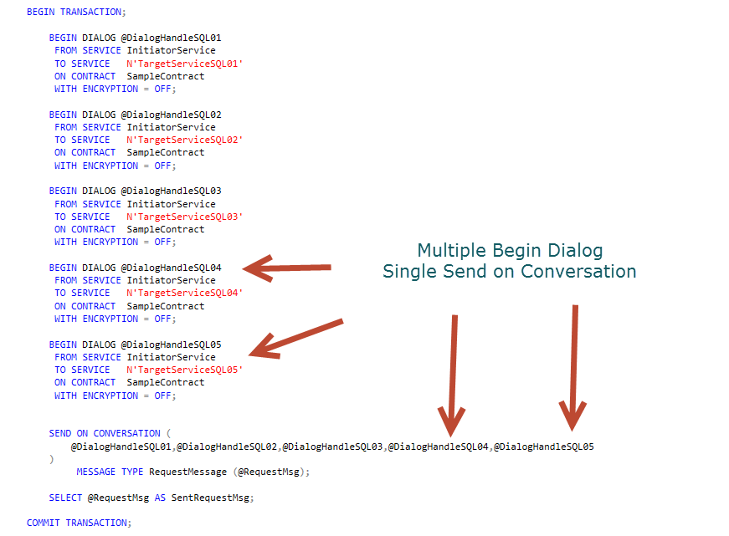
Demo – Service Broker & Multicasting with Docker

Slide 24
SQL Server on Azure …
Not covered in this session
By design
SQL DataWarehouse
Elastic data warehouse as a service
Azure SQL Databases
Sharding / Federation
Elastic pools
Scale up/down
Change service-tiers for a given database
Scale out
Add Remove databases

Slide 25








The future ?
Shopping Cart
Analytics
CSR Rep
Customer
CSR
Stretch
Database
History
Asynchronous
Replication
Availability Group
Shopping Cart OLTP
Probably a mix of solutions
Including hybrid hyprescale architecture
In-Memory ColumnStore
AlwaysOn Asynchronous Replica
Stretch Database
Temporal Database

Slide 26


Q/A
http://GUSS.pro/sqlsat
…Et en plus on peut gagner des cadeaux
Q/A
Thanks for attending
Please, fill the survey
Meet the Community
ATE corner

Slide 27
Merci à nos sponsors

